Slide 1
Highways Safety Hub
Blue Star award ideas
This presentation includes a selection of innovative ideas / suggestions for improvement

Slide 2
Blue Star awards presentation – Part 1 of 5
Selected Blue Star Award ideas

Slide 3
Blue Star awards presentations
Part 1 - Selected Blue Star Award ideas (this presentation)
Part 2 – PPI (Plant Person Interface)
Part 3 – Service avoidance
Part 4 – TM (Traffic management)
Part 5 - Training

Slide 4
Intro / background (Slide 1 of 3)
Through the Highways Safety Hub group, an index listing (database) of Blue Star awards and H&S Toolkit ideas has been produced, a summary of initial findings of which reads as follows:
There has not been a vehicle or process in place to integrate innovations and good ideas recognised through the issue of Blue Star awards (and H&S Toolkit ideas), beyond use by respective teams for and by whom the awards were raised
They were just a method of recording innovation, good ideas and good practices observed through a Client led SH&E inspection process
With the passage of time, and changes in work location (projects), personnel and teams, access to knowledge and implementation in use and development of innovation and good ideas raised, may have been lost (or forgotten)

Slide 5
Intro / background (Slide 2 of 3)
Review of content of Blue Star awards towards the end of 2020, recognised that:
Whilst innovations and good ideas remain, and should always be welcomed and encouraged,
Many of the topics covered are either dated, out-of-date, now seen as business as usual, or superseded by improved processes or systems
Two of the Blue Star awards, demonstrate that site teams did not fully understand safe operating parameters of the subject matter, i.e. Temporary vehicle restraint barrier
By production of this and other presentations (in the series), criticism of content of any award was and is not intended
Instead, review of content of the Blue Star awards provides a unique timeline of development across the highways sector, through innovation and learning by all teams, and it is hoped that this continues to be promoted and welcomed

Slide 6
Intro / background (Slide 3 of 3)
Copies of all Blue Star award documents raised to-date, are available on the Highways Safety Hub web site, nested in the alerts tab page; https://www.highwayssafetyhub.com/toolkit.html
A copy of the database of Blue Star awards and H&S Toolkit ideas, hereafter referred to as the “Blue Star awards index listing”, an Excel File, has been posted onto the Highways Safety Hub web site under the “H&S Toolkit” Tile heading
Content of this presentation includes an index listing of titles of Blue Star awards raised to-date, followed by a selection of ideas, in Blue Star award number
Details of H&S Toolkit ideas (19 off) will be included in a separate presentation

Slide 7
Index listing of Blue Star awards (page 1 of 5)
B000 - Plant person interface, good practice
B001 – Diphoterine
B002 - Traffic management
B003 – Health Wellbeing (Champion)
B004 – Work on bridge deck / Wind monitoring system
B005 – Safetime scaffold tags
B006 – BIM
B007 – RAG batter
B008 – Water mist fire extinguisher
B009 – Smart screens
B010 – Mission Room
B011 – Controlling permits to work
B012 – WAH / Load and unload vehicles
B013 – Gridforce 30
B014 – Dumper camera
B015 – Excavator stickers
B016 – Chapter 8 chevrons
B017 – Occupational health (3 year plan)
B018 – TM airlock
B019 – Health, safety, wellbeing strategy
B020 – Training

Slide 8
Index listing of Blue Star awards (page 2 of 5)
B021 – Readi-guard (RO) TM airlock gates
B022 – Bunkabin accommodation
B023 – Competence
B024 – Technology to improve safety (BIM)
B025 – Red Zone training
B026 – Public route planning
B027 – Safety pegs to maintain TBS zone
B028 – Control of vehicles leaving site
B029 – Vehicle payload and weights sheet
B030 – Message boot laces
B031 – Google maps S&O planning
B032 – LGV enforcement
B033 – HAVwear watches
B034 – LED lights on goal posts
B035 – Briefing document (daily)
B036 – Call button for ped access to site
B037 – QR codes and NFC readers
B038 – Skipper tape exclusion zone
B039 – Value engineering
B040 – Improving communication

Slide 9
Index listing of Blue Star awards (page 3 of 5)
B041 – Incident investigation
B042 – TM (influencing drivers / body cams)
B043 – PatrolLive
B044 – Work behind access and exit points
B045 – Control of HAVS (PAM breaker)
B046 – Safety gates
B047 – Works access gate (WAG)
B048 – Site security)
B049 – A duplication of BS Award 43
B050 – A duplication of BS Award 44
B051 – Animated RAMS
B052 – Yellow mat
B053 – SMART SITE monitors
B054 – Vest and helmet lights
B055 – TM works order management system
B056 – TM nightshift isolation plan
B057 – Service avoidance
B058 – 2-way radios, key info, dumper cam
B059 – Use of stop gates
B060 – Plant person interface training

Slide 10
Index listing of Blue Star awards (page 4 of 5)
B061 – Induction training area 1
B062 – PPI, JCB Hydradig, Prolec restrictors
B063 – LifeVac
B064 – Virtual reality (VR) training
B065 – Rotating dumper cab
B066 – Surface mining (use of Power Plane)
B067 – Occupational health, fatigue
B068 – Service avoidance
B069 – Overhead protection
B070 – Banners (bridge name / No / location)
B071 – Remote drilling (No HAVS)
B072 – MEWP virtual reality training simulator
B073 – Drone tech aerial mapping stockpiles
B074 – Halo Deployment ‘Worker Guardian’
B075 – Base Light 420x portable lighting
B076 – Virtual reality PPI training
B077 – Hi-vis dumper
B078 – Milwaukee 6232 Band saw
B079 – GTL gas to liquids fuel
B080 – VMS overhead protection

Slide 11
Index listing of Blue Star awards (page 5 of 5)
B081 – VMS TM exit
B082 – Trimble site vision
B083 – Survey giraffe
B084 – Public pedestrian safety
New for 2021:
B085 – Emergency call button
B086 – V2 VDZ System

Slide 12
Blue Star awards, issued by calendar year
2015 – 11no.
2016 – 44no. (+2no. Duplicates)
2017 – 12no.
2018 – 11no.
2019 – 2no.
2020 – 3no.
Total = 83no.
2021 –

Slide 13
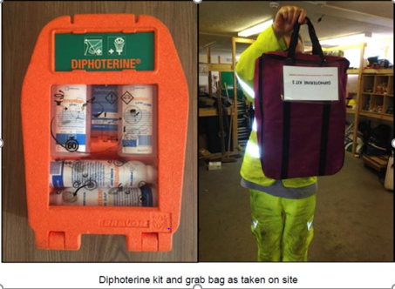
B001 – Diphoterine
A treatment product was identified which is used by the NHS for treating chemical burns and which is available in easy to use formulations that require little to no training or expertise to use and which have been proven to eliminate or substantially reduce injury as a result of exposure to alkalis (such as wet concrete).
The product is called Diphoterine.

Slide 14
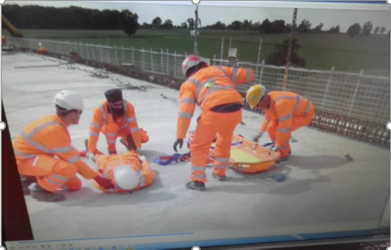
B004 – Work on bridge deck
Work on bridge deck:
Excellent emergency procedures in place
Access to deck restricted, all must be briefed and sign in and out
Wind speed is monitored, no work if in excess of 30mph
Alarm call points located on deck
Air horns used to raise the alarm
Rescue procedures, with training and briefings in place
Man riding basket and stretcher available

Slide 15
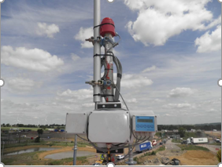
B004 – FlexiMet Wind 1 monitoring system
FlexiMet Wind 1 wind speed and direction monitoring system – Used to quickly alert everyone working on the bridge deck, giving them sufficient time to ensure that all equipment and materials are secured and that everyone can leave the deck safely.

Slide 16
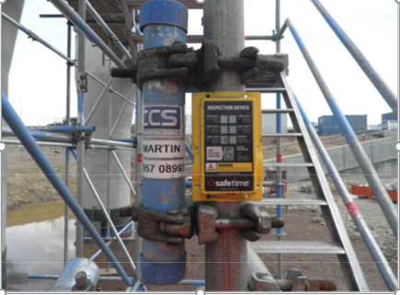
B005 – Safetime scaffold tags
Safetime scaffold tags are controlled by the resident scaffold inspector using mobile phone technology with data recorded by ‘cloud’ technology.
They avoid abuse by persons unknown changing dates, or moving tags (GPS control).
They reduce time by inspectors filling out paperwork, as everything is immediately uploaded straight from the device.

Slide 17
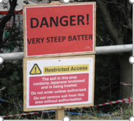
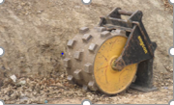
B007 – RAG batter
RAG batter –
A Red Amber Green system to assess risk was introduced for works adjacent to 3 steep embankments, located along much of the site, with signage in place to indicate the RAG status.
Schematic drawings of the site to be drawn up and issued site and displayed in the on-site welfare units.

Slide 18
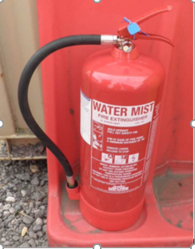
B008 – Water mist fire extinguisher
The extinguisher’s nozzle disperses microscopic ‘dry’ water mist particles to suppress fires and extinguish burning materials
They are safe for use on wood, paper, textiles, flammable liquids and fat fires
They are also great for extinguishing gas fires and can safely be used on electrical equipment up to 35000 Volts
As the extinguisher can be used on most types of fires, less extinguishers and blankets are required

Slide 19
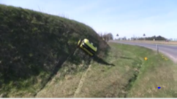
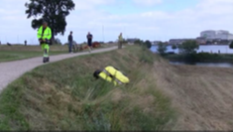
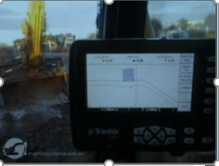
B012 – Work at heights
Work at heights
Some plant has been fitted with GPS to avoid the need for setting out engineers to work at height on batters
Permanent fencing was installed early along the top of cuttings to prevent falls from height, and during the summer, a remote controlled mower was used to cut the grass on some of the steep embankments to reduce the risk of S/T/F’s

Slide 20
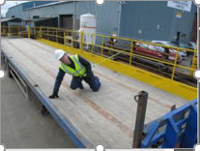
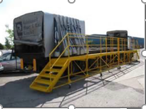
B012 – Load Angel
Loading and unloading vehicles –
including the use of a mobile platform at the main bridge works
This can be placed alongside vehicles to provide a safe working platform and access when unloading plant and materials

Slide 21
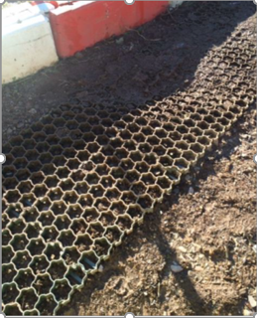
B013 – Gridforce Park 30
Plastic “Gridforce Park 30” cellular mats provide temporary slip/trip free covering for use along routes trafficked by pedestrians in all weather conditions

Slide 22
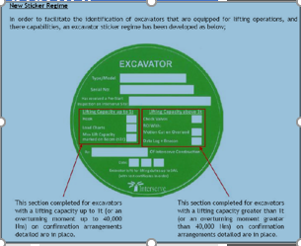
B015 – Excavator stickers
To facilitate identification of excavators equipped for lifting operations, and there capabilities, an excavator sticker regime has been developed.
Stickers will be completed and stuck on the excavator (in a safe location that does not obstruct the operators view) to confirm the excavator meets the requirements for lifting up to its safe working load.

Slide 23
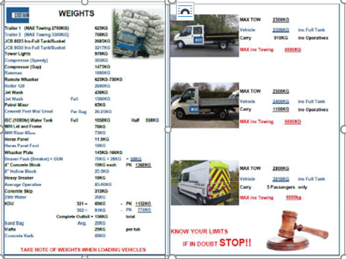
B029 – Vehicle payload and weights sheet
Information sheet that provides clear information of accurate vehicle payloads with additional information of the weights of general materials that are transported on site

Slide 24
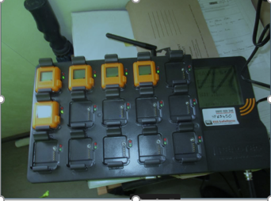
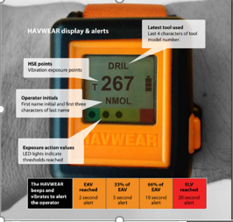
B033 – HAVwear watches
Machine mounted equipment is used to minimise hand held vibrating equipment.
Where no alternative, HAVwear watches are used to record and monitor use.
Similar to the HAVmeter, but the monitor is worn on the wrist by the operative and returned to a docking / base station at end of shift, where data is stored using cloud technology.

Slide 25
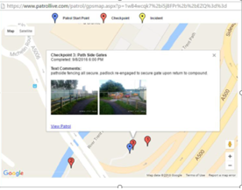
B043 – PatrolLive
The PatrolLive Mobile Phone Application was used on site on the A500 Campbell Road Bridge repairs work location to perform patrols of the site.
A number of virtual checkpoints were set up on site at key locations and patrols carried out at regular intervals.
Checkpoints included;
1. Office/Canteen Portacabins
2. Diesel/Storage Unit
3. Roadside Gate
4. Landfill Area
5. Scaffold Compound
6. Pathside Gate

Slide 26
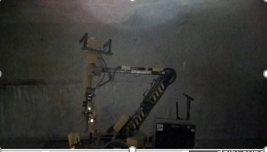
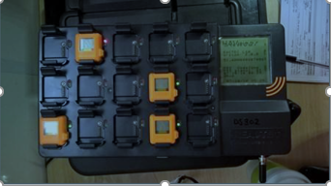
B045 – Control of HAVS
Fully automated Air / Hydraulic powered mechanical PAM breaker used to remove defective concrete from the structure.
Reactec HAVwear system to accurately measure exposure to HAVS when operating vibrating tools, including limit value, accumulated points, and coloured daily exposure warnings (green, amber and red).
PAM Breaker
Reactec HAVwear, base station

Slide 27
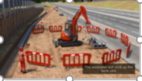
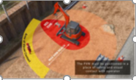
B051 – Animated RAMS
In October 2016, when the Blue Star was awarded, animated RAMS were being developed;
To show the workforce how activities should be carried out safely what equipment should be used, how the work area should be set up, and where operatives should stand etc.
This is particularly useful for briefing to workers who’s 1st language is not English, as it helps to overcome language barriers.

Slide 28
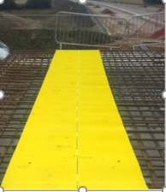
B052 – Yellow Mat
Yellow coloured matting is placed over re-bar to allow safer access and working area for steel fixers, joiners and others, whilst trafficking across re-bar on foot during the construction process
The matting is light weight and easy to move, to allow for changes in work elements / locations
The matting is anti-slip and reduces the chances of slip and trip incidents and associated injuries
Roll size (standard) – 10m long x 1m wide x 3mm thick
Available from: Yellowmat.co.uk

Slide 29
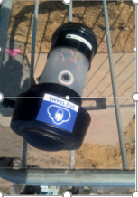
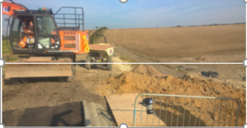
B053 – SMART SITE monitors
SMART SITE is an easily transportable tool that measures real time dust and noise exposure.
The SMART SITE can be used in any environment and helps to protect health of the workforce.
It gives site operatives warnings that they are being over exposed to dust and noise.
It also has GPS so that the location of exposure can be identified at a later date as well as tracking exposures throughout the working day

Slide 30
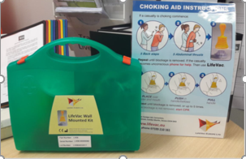
B063 – LifeVac
LifeVac is a simple life saving solution to helping people who are choking
The LifeVac is a non-powered portable suction apparatus developed for resuscitating a choking victim when standard protocol has been followed without success, including black slaps and abdominal thrusts

Slide 31
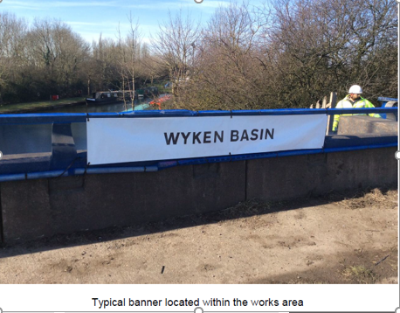
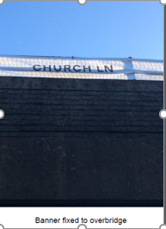
B070 – Banners
Banners –
Have been purchased and fixed to bridges and within the works
They give the location as once works commence the market posts are removed and the project works to chainages
Chainages are confusing to people who are unfamiliar with the system or are new to the project.

Slide 32
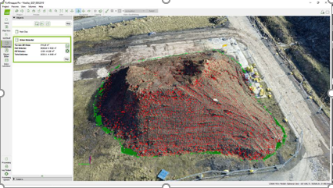
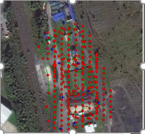
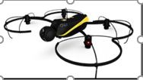
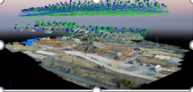
B073 – Drone technology aerial mapping stockpiles
Drone technology aerial mapping stockpiles –
Air Hound, an Aerial mapping company, has been employed to continually monitor and quantify stockpile levels within a storage area used to hold good materials for use on future schemes.
The service can be carried out more efficiently and accurately than traditional methods, freeing up time for other tasks.

Slide 33
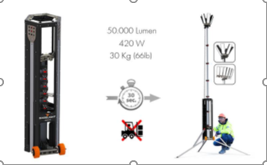
B075 – Base Light 420x portable lighting
Base Light 420x is the only truly portable light system in the world that can produce 50 000 lumens with a power consumption of 420W.
The innovative lens technology makes sure that all available light is placed where it is needed, on the ground.
As a indication of efficiency it easily outperforms a 4x400W halogen system with about 30% more light. At the same time, consuming 75% less energy

Slide 34
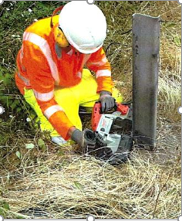
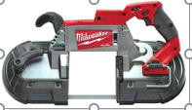
B078 – Milwaukee 6232 Band saw
Use of the Milwaukee 6232 Band Saw was trialled as an alternative method where the risk of fire from hot works was too great to use to use traditional cutting with a circular saw, as well as aiming to reduce exposure to harmful risks of HAVS and noise.
It does not produce sparks and is electrically operated (battery or corded)

Slide 35
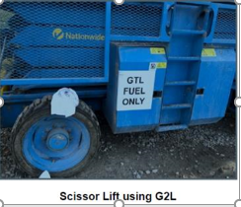
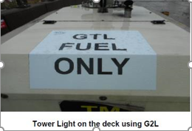
B079 – GTL gas to liquids fuel
Gas to liquids (GTL) is an alternative fuel manufactured from natural gas and burns cleaner than conventional diesel oil
GTL fuel can be used in any diesel engine, regardless if it’s a vehicle, piece of machinery or equipment
There’s no need for any engine modification, new infrastructure or vehicle/machinery investment

Slide 36
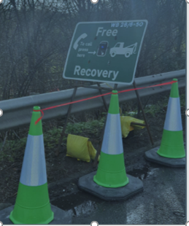
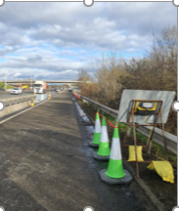
B085 – Emergency call button
HRS’ Portable Emergency Call Point is a customisable and easy to deploy interactive terminal that allows two-way communication between road users who have broken down in the road works or an emergency refuge area and a control room.
The sign face can easily be customised
All devices are monitored remotely and status, number of calls, battery can be seen in a secure web portal

Slide 37
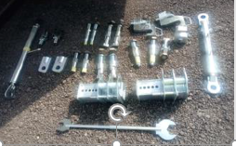
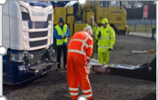
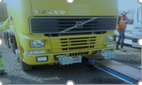
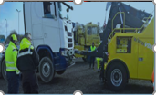
B086 – V2 VDZ System
Saunders Recovery & BBV, supported by Highways England HETO’s have successfully trialled and implemented a new recovery system called VDZ System.
With modern trucks encompassing new technology within design and development for greater payloads, the complex design and manufacture of these trucks requires a new approach for the recovery and transportation should the vehicle require towing

